Slide 1





Gradient-less Federated Gradient Boosting Trees with Learnable Learning Rates
EuroMLSys 2023
Machine Learning Systems Lab
University of Cambridge
Chenyang Ma, Xinchi Qiu, Daniel J. Beutel, Nicholas D. Lane
Notes:
We present our work on gradient-less federated gradient boosting trees with learnable learning rates.

Slide 2
Motivations: The need for federated XGBoost
Existing federated learning (FL) research focuses on deep learning (DL)
XGBoost outperforms DL for tabular data on medium-sized datasets (< 10k) [1, 2]
Industrial need: survival analysis, financial fraud detection, etc.
[1] Léo Grinsztajn, Edouard Oyallon, and Gaël Varoquaux. 2022. Why do tree-based models still outperform deep learning on tabular data? arXiv preprint arXiv:2207.08815 (2022).
[2] Ravid Shwartz-Ziv and Amitai Armon. 2022. Tabular data: Deep learning is not all you need. Information Fusion (2022).
Notes:
Federated learning enables the training of a global model using decentralized datasets in a privacy-preserving manner. Existing FL research mainly focuses on neural networks. The efforts of developing FL algorithms to support other machine learning models, on the other hand, remain under-explored.
XGBoost is a powerful and interpretable gradient-boosted decision tree. In most of the cases, XGBoost outperforms deep learning methods for tabular data on medium-sized datasets under 10 thousand training examples. In the context of cross-silo federated learning, there is a growing need to deploy federated XGBoost on tasks such as survival analysis and financial fraud detection.

Slide 3
Horizontal vs. Vertical Federated XGBoost
Current research adopts two settings with practical applications
Features
Labels
Features
Features
Labels
Features
Features
Labels
Features
Passive parties
Active party
(a) Horizontal Setting
(b) Vertical Setting
Notes:
Current research on federated XGBoost defines two settings. In the horizontal setting, clients' datasets have identical feature spaces but different sample IDs. The central server sends the global model to all clients and then aggregates the updated model parameters after each communication round. In the vertical setting, the concepts of passive parties and one active party were introduced, where passive parties and the active party share identical sample space but possess different features. As only the active party owns data labels, it naturally acts as the server.

Slide 4
Horizontal vs. Vertical Federated XGBoost
Current research adopts two settings with practical applications
Features
Labels
Features
Features
Labels
Features
Features
Labels
Features
Passive parties
Active party
(a) Horizontal Setting
(b) Vertical Setting
Notes:
Our work focuses on the horizontal setting, and it is the more common one.

Slide 5
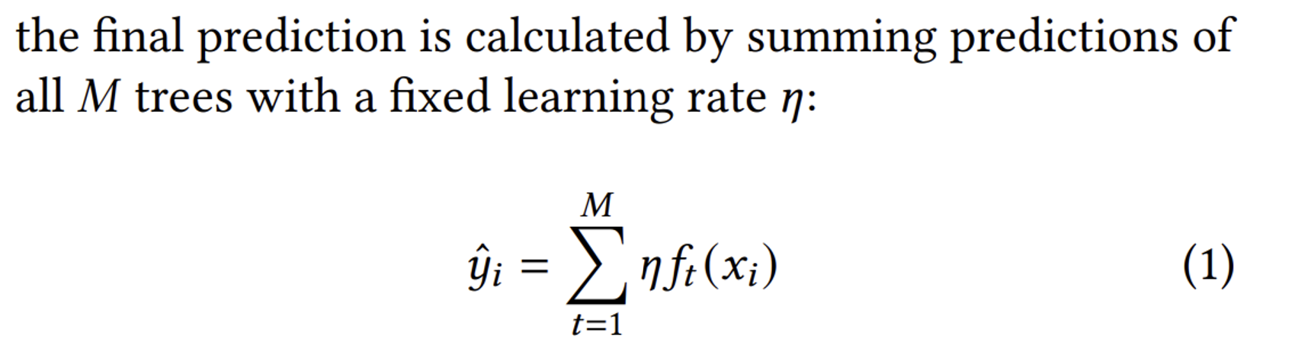

Horizontal setting is more common, but Harder
To understand why, we review the fundamentals of XGBoost
Additive ensemble model: forward stagewise regression and consistently learns new trees to fit the residuals
$f_{t}$ is a single tree in the tree ensemble, ${\hat{y}}_{i} is$ the prediction, $x_{i}$ is the input data point
Notes:
Although the horizontal setting remains to be more common, the training of a horizontal federated XGBoost turns out to be harder. To understand why, we need to review the fundamentals of XGBoost.
XGBoost is an additive ensemble model. It adopts forward stagewise regression and consistently learns new trees to fit the residuals until a stop condition is met. Suppose there are M trees in the tree ensemble, given a data point xi, the final prediction is calculated by summing predictions of all M trees with a fixed learning rate eta.

Slide 6
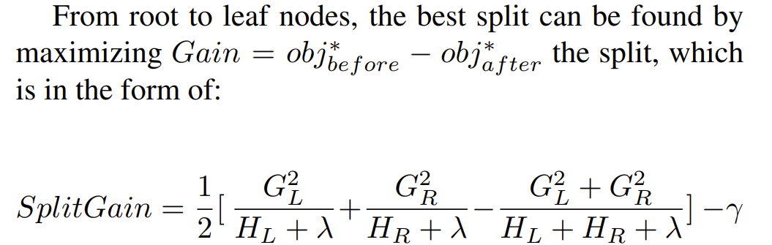
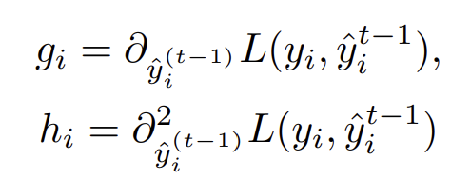
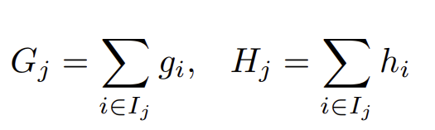
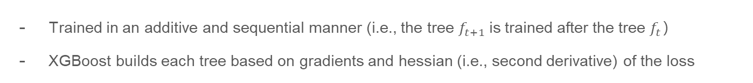
Horizontal Setting is more common, but Harder
Trained in an additive and sequential manner (i.e., the tree $f_{t+1}$is trained after the tree $f_{t}$）
XGBoost builds each tree based on gradients and hessian (i.e., second derivative) of the loss
(2)
(3)
Notes:
XGBoost is trained in an additive and sequential manner, which means the tree ft+1 is trained after the tree ft.
To train a single tree, we first calculate the first order-gradient, gi, and second-order hessian, hi, of all data samples as shown in equation 3. From root to leaf nodes, the best split can be found by maximizing Split Gain, as shown in equation 2. The Split Gain at every node is calculated with regards to the sums of the gradients and hessians of the data samples partitioned into the left and right branch based on the splitting point's feature condition.

Slide 7
Gradients must be shared in horizontal setting
Finding the optimal split condition of XGBoost trees depends on the order of the data samples [1]
(2)
(3)
[1] Zhihua Tian, Rui Zhang, Xiaoyang Hou, Jian Liu, and Kui Ren. 2020. FederBoost: Private Federated Learning for GBDT. arXiv abs/2011.0
Notes:
So why is horizontal federated XGBoost harder? This is because finding the optimal split condition of a single tree depends on the order of the data samples as we see in equation 2, we iterate the feature set and partition the data samples into left and right according to the feature constraints. Therefore, as all clients share the same sample IDs in the vertical setting, the passive parties only need to send the order of the data samples to the active party without revealing the actual values of the gradients and hessians.

Slide 8
Gradients must be shared in horizontal setting
Finding the optimal split condition of XGBoost trees depends on the order of the data samples [1]
(2)
(3)
Distributed across clients
[1] Zhihua Tian, Rui Zhang, Xiaoyang Hou, Jian Liu, and Kui Ren. 2020. FederBoost: Private Federated Learning for GBDT. arXiv abs/2011.0
Notes:
However, since the sample IDs are different across all clients in the horizontal setting, in another word, the instance set I_{j} on each leaf node, defined in equation 3, is decentralized. At every splitting point, each client needs to transmit the gradients, hessians, and sample splits based on the feature values to the server to find the optimal splitting condition.

Slide 9
Gradients must be shared in horizontal setting
Finding the optimal split condition of XGBoost trees depends on the order of the data samples [1]
(2)
(3)
Distributed across clients
[1] Zhihua Tian, Rui Zhang, Xiaoyang Hou, Jian Liu, and Kui Ren. 2020. FederBoost: Private Federated Learning for GBDT. arXiv abs/2011.0
Notes:
And only in this way, we can know the partitioning of data samples into left or right for each client's unique sample IDs in order to calculate the global G_{L} and H_{L}, as well as G_{R} and H_{R}, required by equation 2.

Slide 10
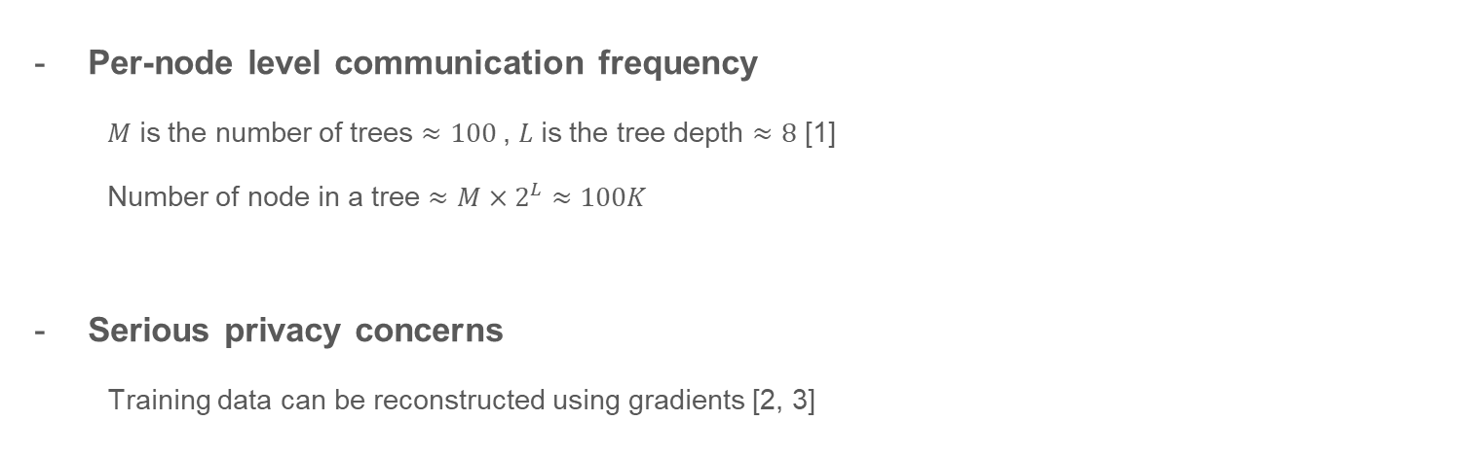
Sharing Gradients in the horizontal setting causes two key problems
Per-node level communication frequency
$M$ is the number of trees $≈100$, $L$is the tree depth $≈8$ [1]
Number of node in a tree $≈M×2^{L}≈100K$
Serious privacy concerns
Training data can be reconstructed using gradients [2, 3]
[1] Tianqi Chen and Carlos Guestrin. 2016. XGBoost: A Scalable Tree Boosting System (Conference on Knowledge Discovery and Data Mining).
[2] Matt Fredrikson, Somesh Jha, and Thomas Ristenpart. 2015. Model Inversion Attacks that Exploit Confidence Information and Basic Countermeasures. In CCS.
[3] Ligeng Zhu, Zhijian Liu, and Song Han. 2019. Deep Leakage from Gradients. In Advances in Neural Information Processing Systems.
Notes:
Consequently, we identify two key problems raised by this vanilla approach.
The first is per-node level communication frequency. The server needs to communicate with all clients at every splitting point. We denote the depth of each tree as L and the number of trees in the tree ensemble as M. The number of nodes in the tree ensemble can scale up to M × 2L, and so is the number of communication rounds. As a trained XGBoost model is common to have a depth of 8 and 500 trees, the number of communication rounds can reach 100 thousands. Moreover, in a real application of federated XGBoost, it is possible for the server to conduct more than one round of communication per node and carry out extra cryptographic calculations. Thus, the high communication overhead makes it difficult to deploy horizontal federated XGBoost for practical uses.
The second is serious privacy concerns. The sharing of gradients is proved to be dangerous in the previous works. As the training data can be reconstructed using gradients, such sharing needs to be protected.

Slide 11
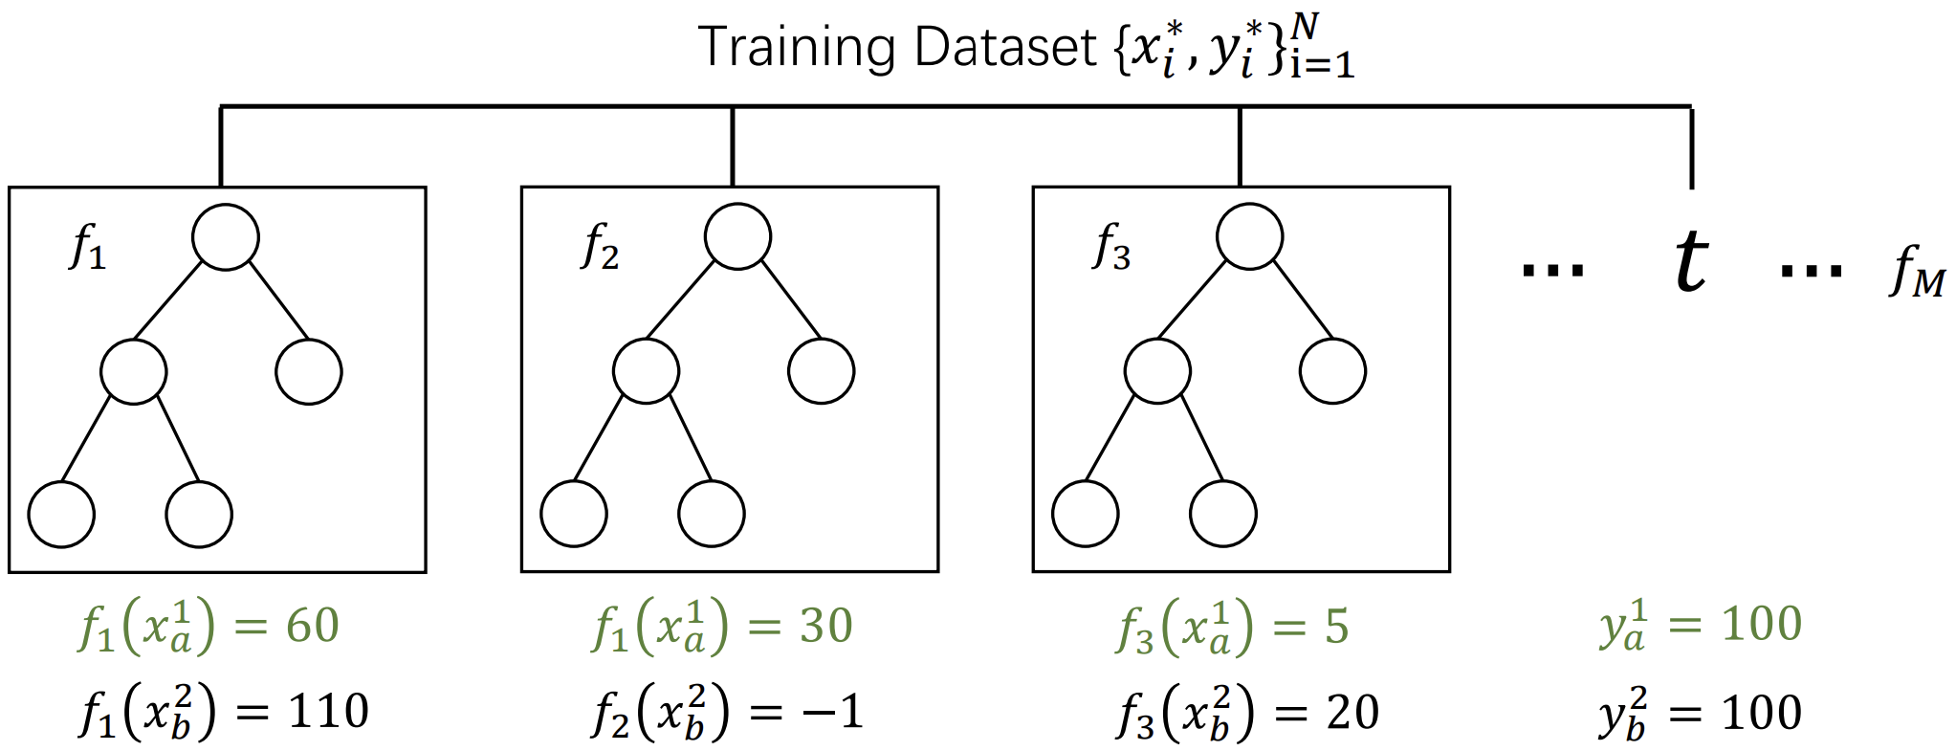
Proposed Method --- Can we not rely on sharing gradients?
The first key insight: Local client’s dataset may be heterogenous. Each tree makes different “amount of mistakes”, as shown below. A fixed learning rate is too weak.
Notes:
In this work, we ask the fundamental question: if it is possible not to rely on the sharing of gradients and hessians to construct a federated XGBoost? In this way, we can simultaneously boost privacy and disentangle the per-node level communication frequency. We find it to be possible by formulating two important insights. The first one is as the local datasets of clients can be heterogeneous in the horizontal setting, using a fixed learning rate for each tree may be too weak since each tree can make different amounts of mistakes on unseen data with distribution shifts.
Consider this example. We have an XGBoost model withx M trees. The XGBoost model is trained on the dataset for a regression task. We send this XGBoost model to two other clients and evaluate on their respective local datasets.
We observe the prediction outcomes of the first three trees in the XGBoost tree ensemble on two data samples xa and xb. Their ground truths are equal and both are 100. Since local datasets belonged to the two clients are hetergenoues, the trees perform differently across data samples. For the first tree f_1, it gives a good initial prediction for x_b but not for x_a. The second and third trees f_2 and f_3, on the contrary, sufficiently correct the residuals made by the first tree f_1 for x_a but not for x_b. In this case, a fixed learning rate may be too weak because ideally, we want a higher learning rate for f_2 and f_3 on x_a but a lower learning rate for f_2 and f_3 on x_b.

Slide 12
Proposed Method --- Can we not rely on sharing gradients?
The second key insight: applying a weighted sum on the diverse prediction results given by all XGBoost tree ensembles can lead to a more accurate final prediction value, helping us to move towards the global optima.
FedAvg [1] and FedProx [2] have given theoretical convergence.
[1] McMahan et al. 2017. Communication-efficient learning of deep networks from decentralized data. In International Conference on Artificial Intelligence and Statistics.
[2] Tian Li, Anit Kumar Sahu, Manzil Zaheer, Maziar Sanjabi, Ameet Talwalkar, and Virginia Smith. 2020. Federated Optimization in Heterogeneous Networks. In MLSys.
Notes:
The second insight is data heterogeneity causes the trained XGBoost models on different clients' local datasets to converge to local optima that are far from each other. Consequently, given an unseen data sample, these XGBoost tree ensembles output different prediction results. However, among all tree ensembles, some can give more accurate predictions because the unseen data sample may be closer to the underlying distribution of their trained datasets. Thus, applying a weighted sum on the diverse prediction results given by all XGBoost tree ensembles can lead to a more accurate final prediction value, helping us to move towards the global optima.
It is important to point out that the approach of utilizing weighted sum to converge to the global optima is proved to be effective in the previous literature such as FedAvg and FedProx, and they have given theoretical convergence guarantees for this method.

Slide 13
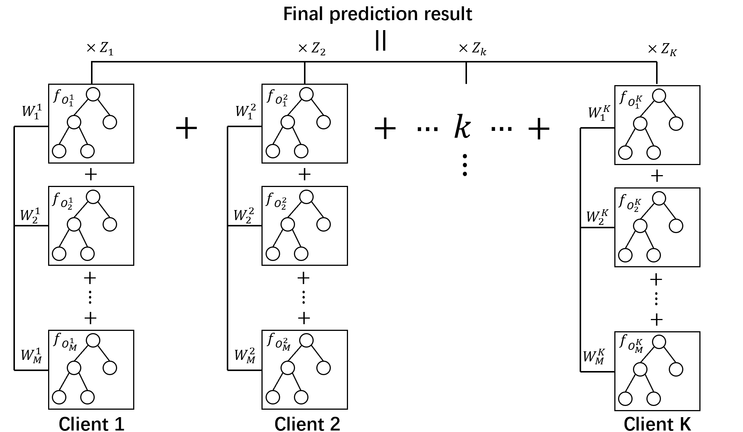
Proposed Method --- Learnable learning rate
Notes:
So to facilitate our insights, the final prediction result given an arbitrary data sample with feature dimension D is calculated by the weighted sum of all trees from all clients as shown in this figure. Each vertical tree chain is the tree ensemble built by one client, where W is the learning rate assigned to each tree and Z_k is the weight applied to the prediction result calculated by client k’s tree ensemble.
We refer to this system as the aggregated tree ensembles, but one question is how to make the W and Z learnable during the training process.

Slide 14
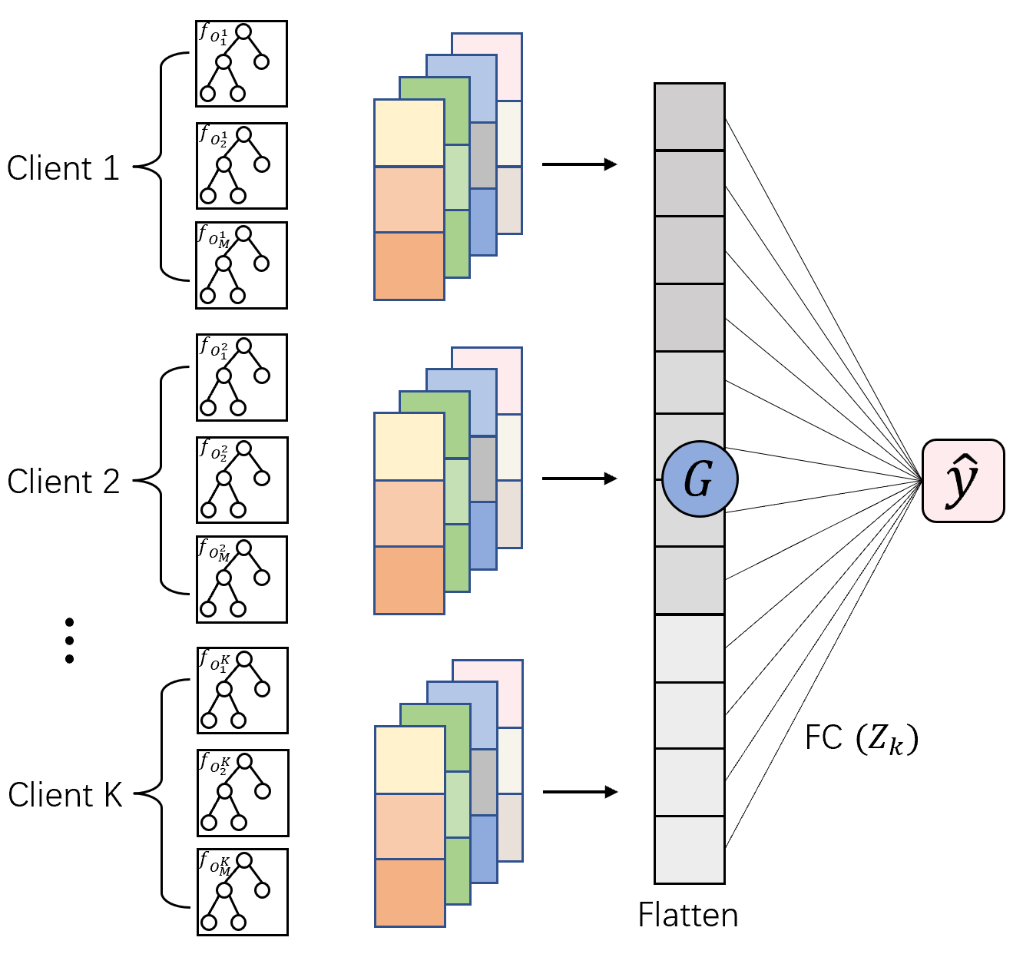
Proposed Method --- Learnable learning rate by interpretable 1-layer 1D CNN
1D Convolution with large Kernel = large Stride = number of local trees
Output channel represents the number of learning rate strategy
Notes:
We find we can make it possible by transforming the aggregated tree ensembles to a one-layer 1D convolutional neural network. In the first 1D convolution layer, the inputs are the prediction outcome of all trees.
The small-sized CNN is interpretable. The kernel size and stride of the 1D convolution are equal to the number of trees in each client's tree ensemble. Thus, each channel of the 1D convolution is the learnable learning rates for the tree ensemble of a specific client, and the number of convolution channels can be understood as the number of learning rate strategies that can be applied. The classification head, which is the fully connected layer, contains the weighting factors Z to balance the prediction outcomes of each client's tree ensemble and calculate the final prediction result.

Slide 15
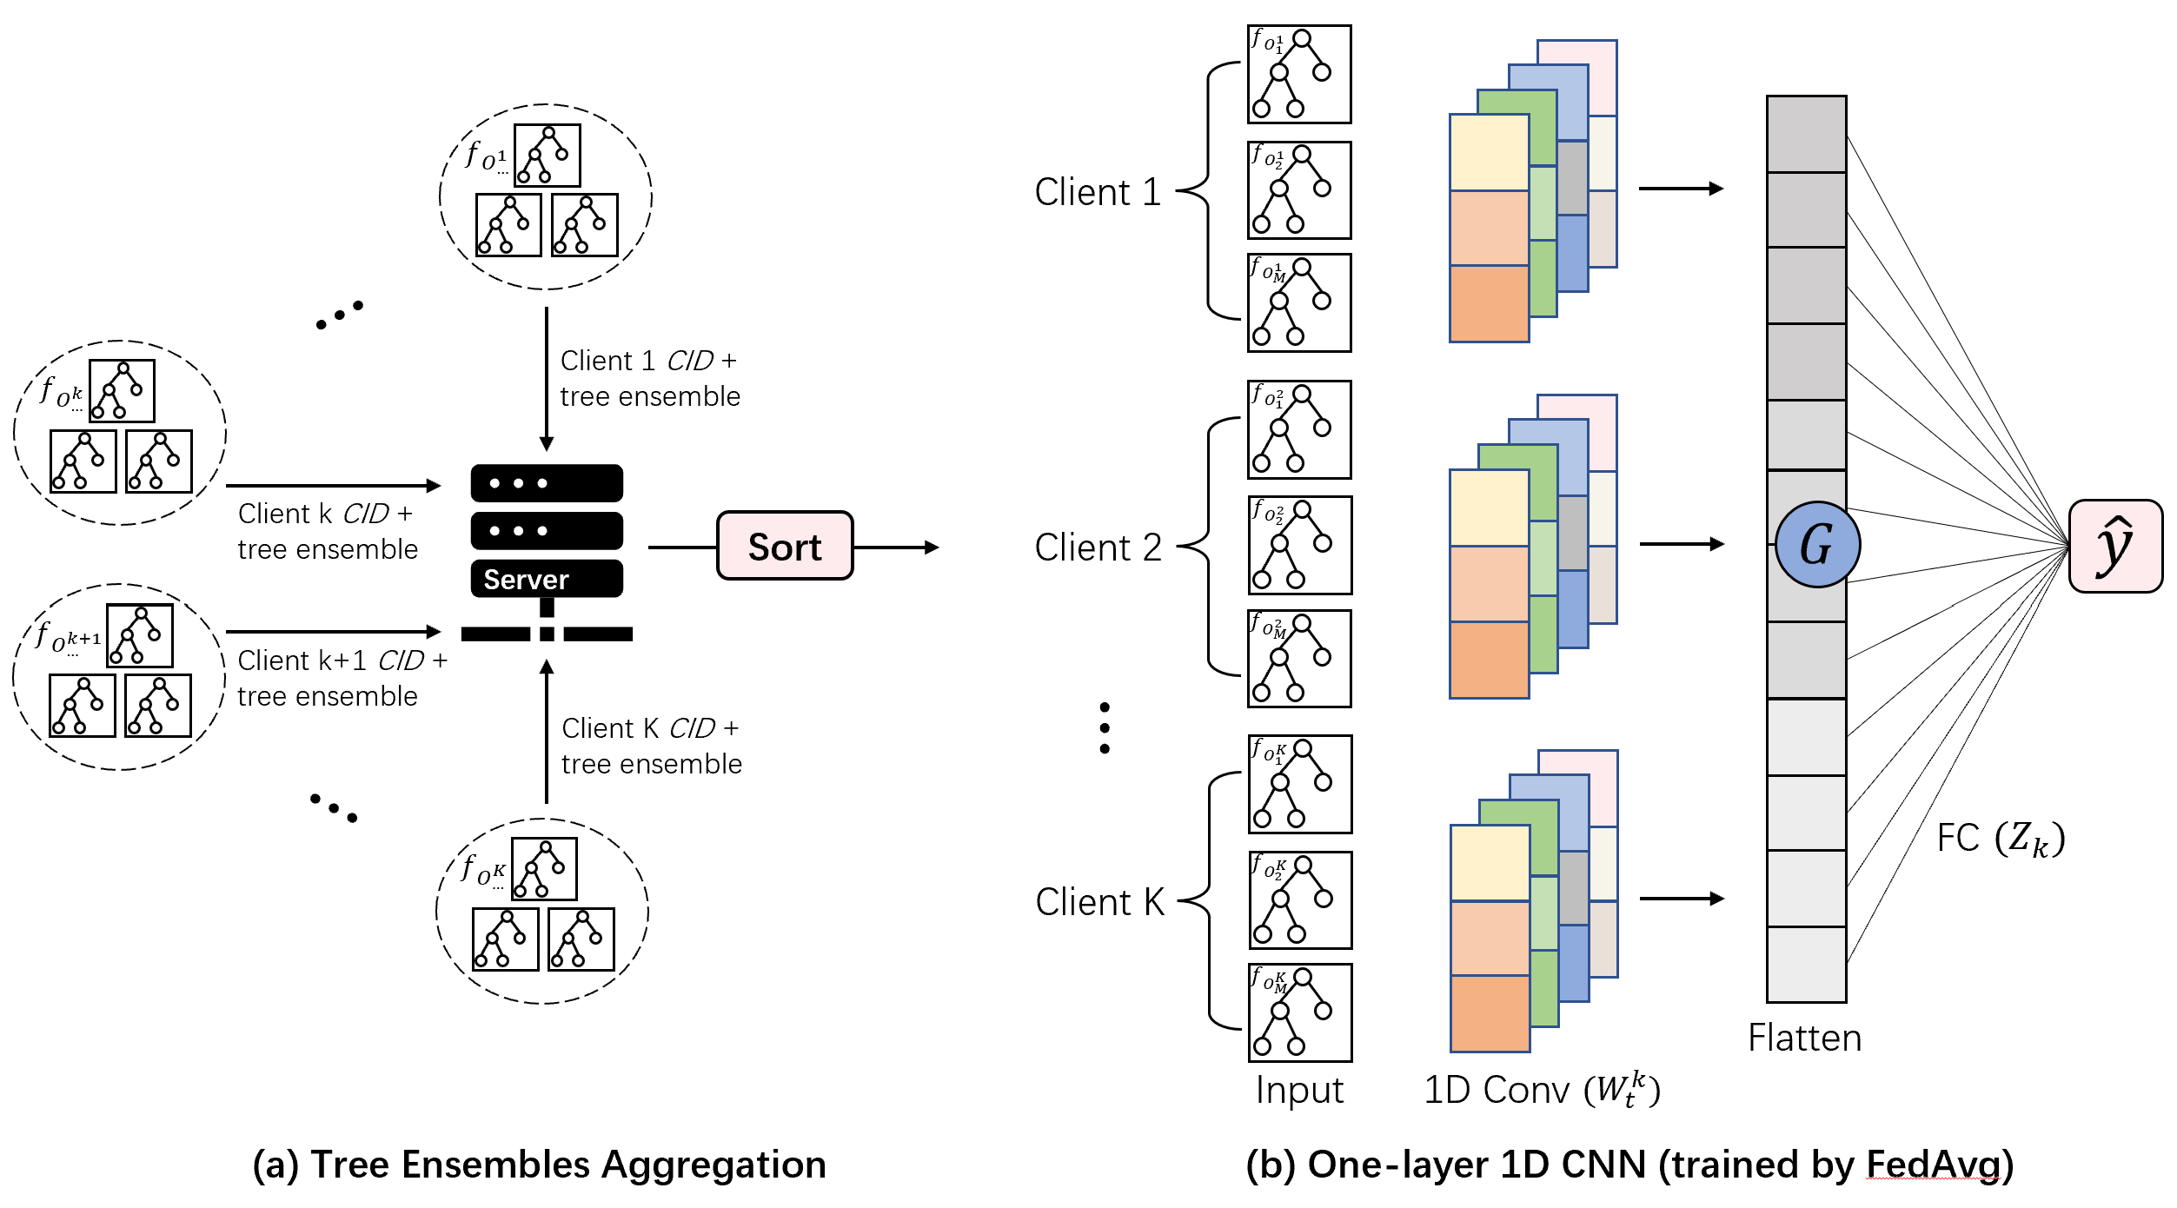
Proposed Method --- Learnable learning rate by interpretable 1-layer 1D CNN
Notes:
Here is our full pipeline.
Each client first trains its local XGBoost tree ensemble. The server then conducts tree ensemble aggregation and CNN initialization. After receiving the aggregated tree ensemble, all clients calculate the prediction outcomes given the aggregated tree ensemble on their local data samples. The calculated prediction outcomes are inputs of the CNN. It is worth noticing that the clients only build XGBoost models at round 1, and the aggregated tree ensemble is fixed after round 1. For the federated training of the one-layer 1D CNN, the protocol follows the standard FL algorithm, and we use FedAvg.
The trained global federated XGBoost model consists of all clients' locally trained XGBoost tree ensembles and the globally trained one-layer 1D CNN.

Slide 16
Advantages of FedXGBllr
FedXGBllr: a federated XGBoost with learnable learning rates
Notes:
We name our framework FedXGBllr, a federated XGBoost with learnable learning rates.

Slide 17
Advantages of FedXGBllr
Privacy protection:
The clients only need to send the constructed tree ensemble to the server
Lower communication overhead:
Independent of dataset size, any hyperparameter related to the trained XGBoost
The number of communication round = training round
Experiments show that 10 communication rounds reaches SOTA
Notes:
FedXGBllr brings two important advantages compared to the previous methods.
The first one is privacy protection; the clients only need to send the constructed tree ensemble to the server. The sharing of gradients and hessians, which may leak sensitive information, is not required.
The second is significantly lower communication overhead. The number of communication rounds of FedXGBllr is independent of any hyperparameter related to the trained XGBoost and the dataset size. In practice, we find 10 communication rounds to be sufficient for the global federated XGBoost model to reach performance comparable to the state-of-the-art method.

Slide 18
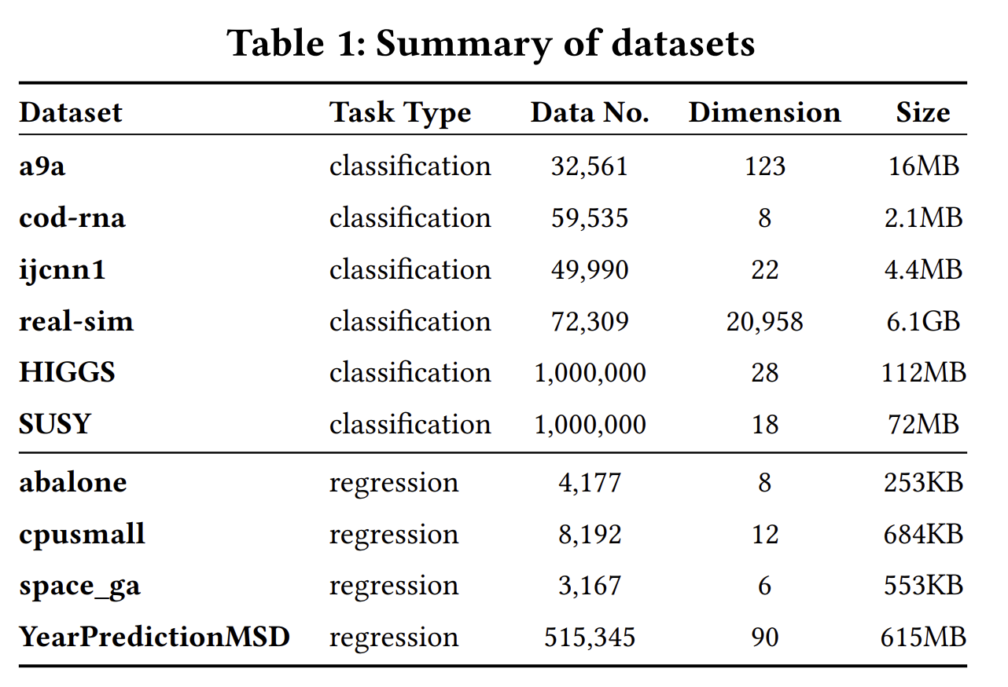
Experiments
Baseline:
1. Centralized XBoost
2. SimFL [1]
[1] Qinbin Li, Zeyi Wen, and Bingsheng He. 2020. Practical Federated Gradient Boosting Decision Trees. In AAAI.
Notes:
For experiments, we benchmark our method against one of the state-of-the-art works on horizontal federated XGBoost, SimFL, which adopts locality-sensitive hashing in the context of federated learning. We also use the centralized XGBoost trained on the whole dataset as baseline.
we evaluate our method on six tabular datasets for classification and four tabular datasets for regression. All datasets have different characteristics and sizes.

Slide 19
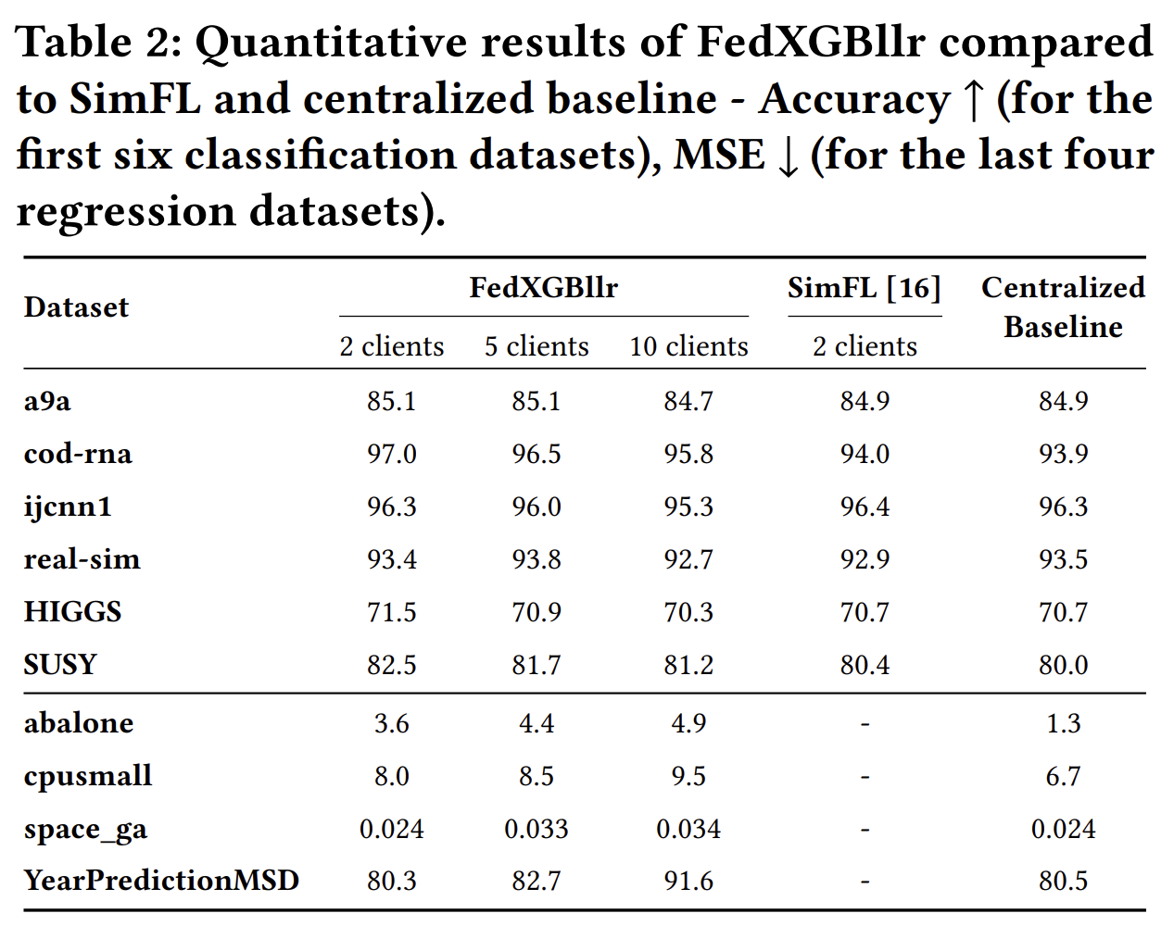
Experiments
Notes:
This table demonstrates the quantitative results of our method. The number of communication rounds is set to 10. From the results, our approach outperforms or reaches comparable accuracy to SimFL and the centralized baselines on all six classification datasets with 2 clients. For the regression datasets, our approach achieves comparable or slightly higher MSE compared to the centralized baseline.
For both classification and regression datasets, our method performs better on larger datasets. We hypothesize this is due to the generalization capability of CNN scaling up with the volume of data. Additionally, as the number of clients increases from 2 to 5 and 10, the performance slightly decreases. We think it is reasonable because federated learning is harder with more clients.

Slide 20
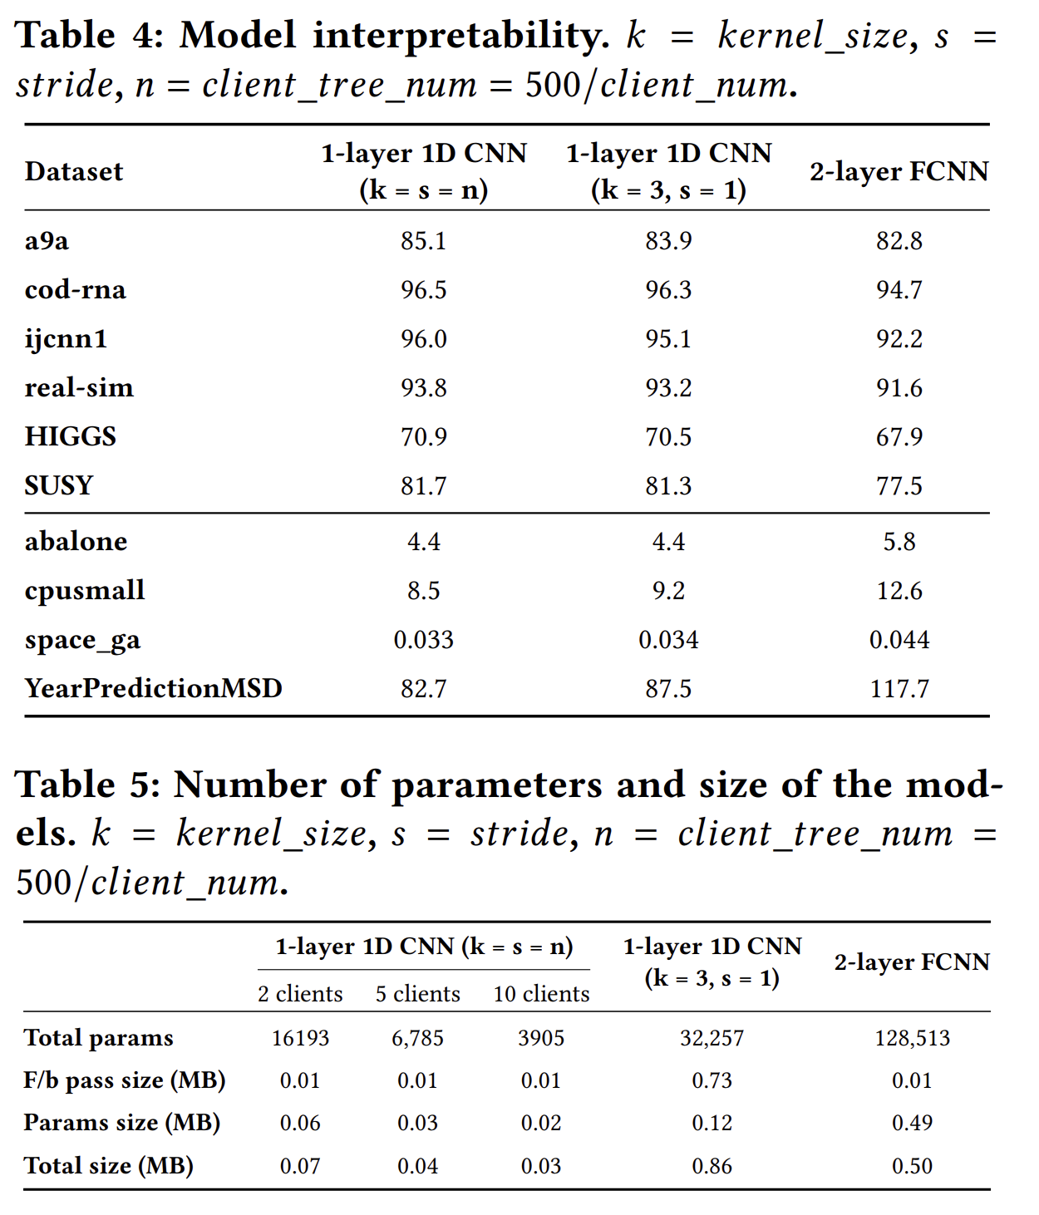
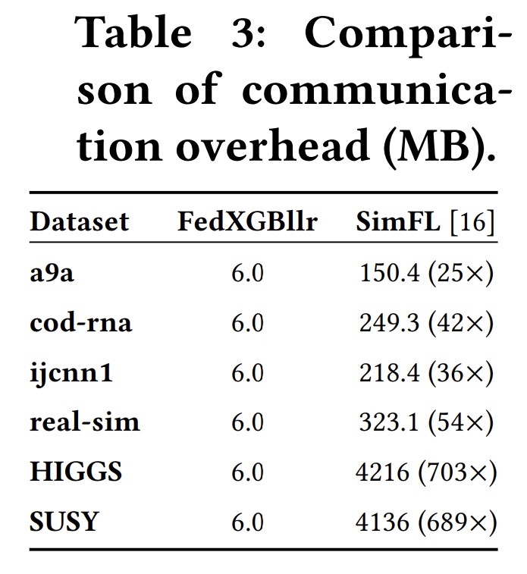
Ablation Studies
Notes:
We also carry out two ablation studies. In the left table, we compare the total communication overhead to build a global federated XGBoost model of our approach to our baseline, SimFL. Because the communication overhead of our method is independent of the dataset size, we can see our communication overhead is significantly lower especially as the dataset size scales up. We save the communication cost by a factor ranging from 25 to 700.
In the right table, we want to know if the interpretability of our one-layer 1D CNN couples with the high performance? We change the first 1D convolution layer with kernel size and stride equal to the number of trees in each client tree ensemble with: standard convolution with kernel size 3, stride 1, and fully connected layer with dimension 256, and remove the flattened layer.
From the results, our one-layer 1D CNN reaches the best performance on all datasets although it has the smallest number of parameters and total size. This suggests the effectiveness and interpretability of our CNN model. We find that for all datasets, the performance gap between our interpretable CNN and 2-layer fully connected neural network is much larger than the gap between our interpretable CNN and CNN with standard kernel size and stride. Also, the gap exaggerates as the dataset size increases. We argue that in addition to our previous reasoning, it is because CNN can leverage the temporal information across the tree ensembles built by the clients, and our interpretable CNN has the right amount of temporal resolution by setting kernel size and stride equal to the number of trees in the clients’ tree ensemble.

Slide 21
Thank you!
Notes:
Thank you for your time. You can refer to our paper for the complete technical details.

